Slide 1
Voice Controlled and Obstacle Avoidance Robot Car

Slide 2
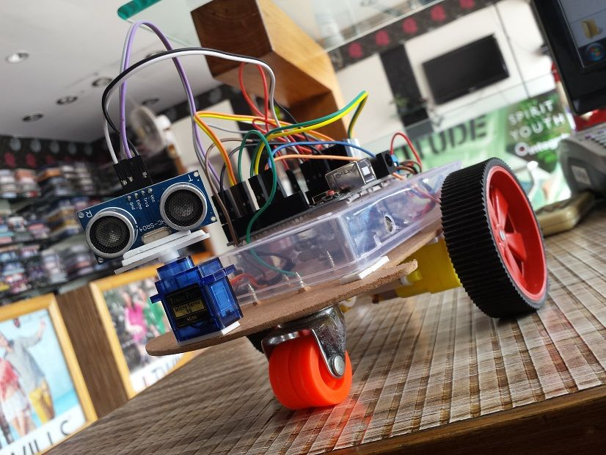
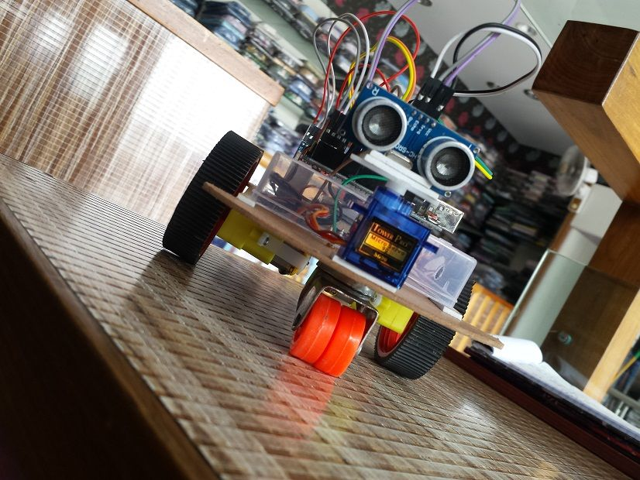
The model

Slide 3
About The Model
The model is about a voice controlled robot car using a bluetooth module and a smartphone. In this project we will be constructing a voice controlled robot car. This will work as we give voice instruction via our smartphone which will be connected to the robot via bluetooth. Initially the robot will be working on everyone’s instruction but gradually we will improvise it such that it only works for the specific voices that are stored in it. This will be done by voice identification process.

Slide 4
The Equipment Required And Where To Get Them
Arduino Uno
L293D Motor Shield: ebay.in-price Rs 199
Bluetooth Module (HC06): ebay.in-price Rs 328
DC Motor and Wheel x2: ebay.in-price Rs 270
Bovine wheel
Wires
Breadboard : ebay.in- price Rs 48
Chassis: Need to be made by cardboard.
Battery and Battery buckle

Slide 5
Connections
Bluetooth RX connect to the Arduino TX input
Bluetooth TX connect to the Arduino RX input
The Motor Shield attach to the Arduino board
The Arduino GND connect to the Bluetooth module GND
The Arduino +5V connect to the Bluetooth module VCC
Left DC Motor connect to the Motor Shield M1 inputs
Right DC Motor connect to the Motor Shield M2 inputs
Battery buckle connect to the Motor Shield +V and GND

Slide 6
Arduino Code
/*
-----------------------------------------
Mert Arduino Tutorial and Projects
Subscribe for more videos and projects
Thanks all subscribers ;)
----------------------------------------
*/
#include <AFMotor.h> //Adafruit Motor Shield Library. First you must download and install AFMotor library
#include <Servo.h> //Servo library. This is standard library. (Sketch -> Include Library -> Servo)
String voice;
AF_DCMotor motor1 (1, MOTOR12_1KHZ); //create motor #1 using M1 output on Motor Drive Shield, set to 1kHz PWM frequency
AF_DCMotor motor2 (2, MOTOR12_1KHZ); //create motor #2 using M2 output on Motor Drive Shield, set to 1kHz PWM frequency
Servo myServo; //define servo name

Slide 7
int LED1 = A0; //define LED 1 pin int LED2 = A1; //define LED 2 pin int buzzerPin = A2; //define buzzer pin void setup() { Serial.begin(9600); //start serial communication myServo.attach(10); //define our servo pin (the motor shield servo1 input = digital pin 10) myServo.write(90); //servo position is 90 degrees pinMode(LED1, OUTPUT); //A0 is output pin pinMode(LED2, OUTPUT); //A1 is output pin pinMode(buzzerPin, OUTPUT); //A2 is output pin } void loop() { while (Serial.available()){ //Check if there is an available byte to read delay(10); //Delay added to make thing stable char c = Serial.read(); //Conduct a serial read if (c == '#') {break;} //Exit the loop when the # is detected after the word voice += c; //Shorthand for voice = voice + c } if (voice.length() > 0){ if(voice == "*go ahead"){ forward_car(); }

Slide 8
else if(voice == "*go back"){ back_car(); } else if(voice == "*turn right") { right_car(); } else if(voice == "*turn left") { left_car(); } else if(voice == "*turn on light") { LED_on(); } else if(voice == "*turn off light") { LED_off(); } else if(voice == "*buzzer") { buzzer_on(); } else if(voice == "*stop") { stop_car(); } voice=""; //Reset the variable after initiating } }

Slide 9
void forward_car() { motor1.run(FORWARD); motor1.setSpeed(170); motor2.run(FORWARD); motor2.setSpeed(170); delay(2000); motor1.run(RELEASE); motor2.run(RELEASE); } void back_car() { motor1.run(BACKWARD); motor1.setSpeed(170); motor2.run(BACKWARD); motor2.setSpeed(170); delay(2000); motor1.run(RELEASE); motor2.run(RELEASE); } void right_car() { myServo.write(0); delay(1000); myServo.write(90); delay(1000); motor1.run(FORWARD); motor1.setSpeed(170);

Slide 10
motor2.run(BACKWARD); motor2.setSpeed(170); delay(1000); motor1.run(RELEASE); motor2.run(RELEASE); } void left_car() { myServo.write(180); delay(1000); myServo.write(90); delay(1000); motor1.run(BACKWARD); motor1.setSpeed(170); motor2.run(FORWARD); motor2.setSpeed(170); delay(1000); motor1.run(RELEASE); motor2.run(RELEASE); } void LED_on () { digitalWrite(LED1, HIGH); digitalWrite(LED2, HIGH); }

Slide 11
void LED_off () { digitalWrite(LED1, LOW); digitalWrite(LED2, LOW); } void buzzer_on () { tone(buzzerPin, 100); delay(800); noTone(buzzerPin); } void stop_car () { motor1.run(RELEASE); motor2.run(RELEASE); }

Slide 12
Thank You For Watching… Suggestions are always welcome

